Slide 1

When AI , Big Data and Ethics converge -
Ethics, Human Rights and AI Governance
Prof. Bernd Carsten STAHL, De Montfort University, Leicester, UK
www.project-sherpa.eu

Slide 2

The Centre for Computing and Social Responsibility
De Montfort University, Leicester, UK
Overview:
Established 1996
Members
    20 research active members
    15+ visiting Profs und Research Associates
ETHICOMP conference series
Journal of Information, Ethics and Communication in Society, ORBIT journal
~6 live projects, EU, EPSRC, ESRC

Slide 3
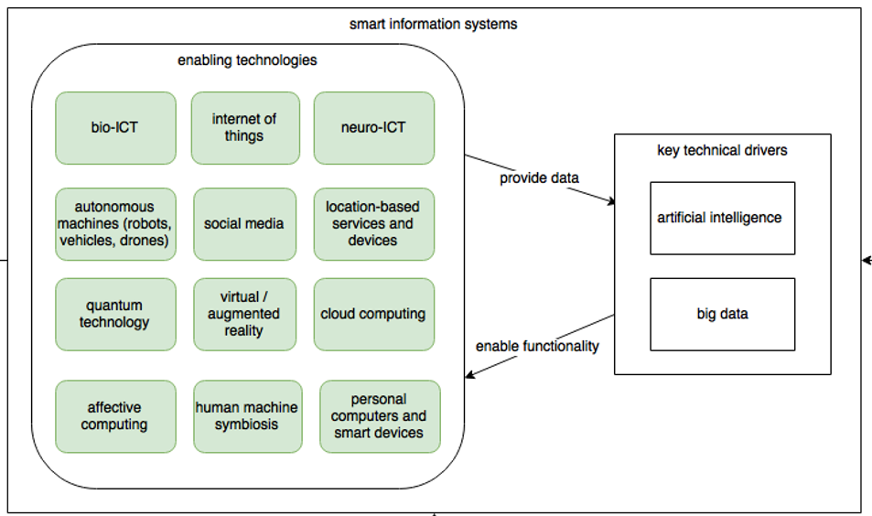
Smart Information Systems

Slide 4




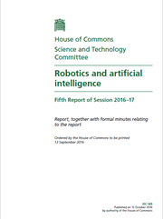



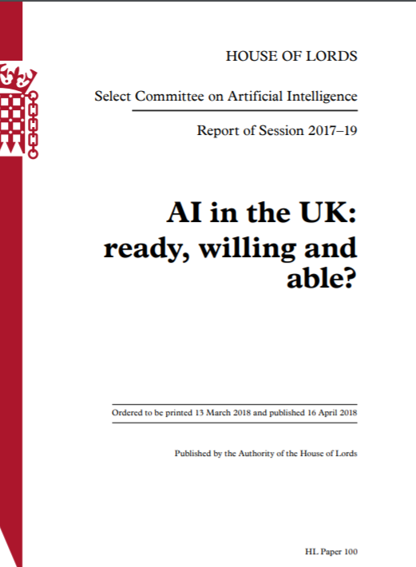

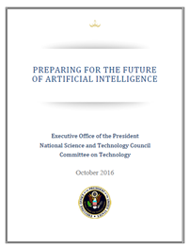
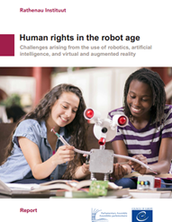
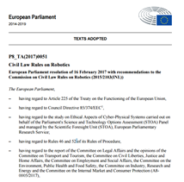


What can I say that is novel?

Slide 5
What do we mean by “Ethics of AI”?
Bias
Specific issues of machine learning
Discrimination
Security
Ethics of AI
Data protection
Autonomy
General questions about living in a digital world
(Economic) Power
Warfare
Superintelligence

Slide 6

Desired outcomes
Economic growth for all
Addressing global challenges (Sustainable Development Goals) & societal missions
Better (personalised) services
Increased human capabilities (compensate disabilities)
Inclusion & democratic participation
Empowerment

Slide 7
Understanding AI – A Multimethod Approach
5 Scenarios
10 Case studies
Analysis of cyber threats
AI – social and conceptual reality
Human rights
Ethical impacts

Slide 8





Case Studies
Government
Agriculture
IoT
Sustainability - Smart Cities
Science

Slide 9



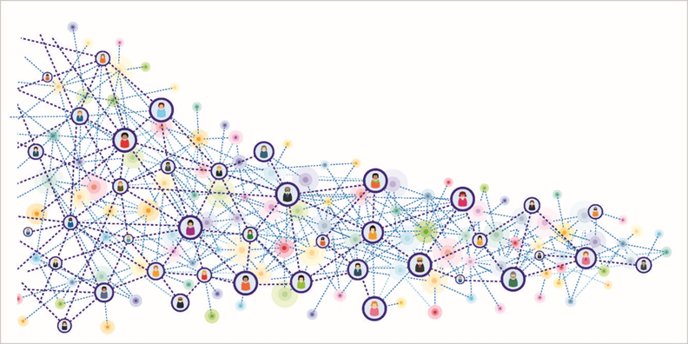

Case Studies
Insurance
Energy and Utilities
Communication, Media
Retail and Trade
Manufacturing

Slide 10




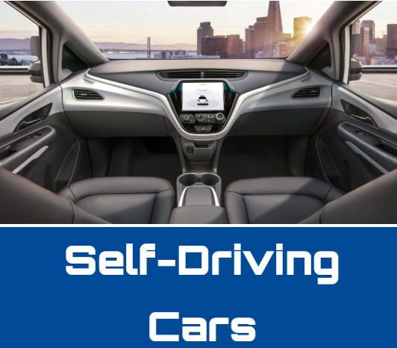
Scenarios
https://www.project-sherpa.eu/future-scenarios/

Slide 11
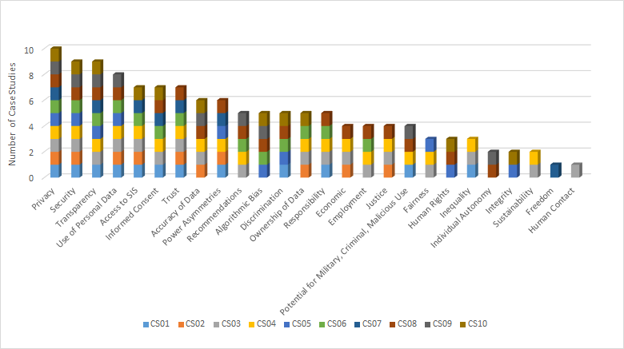
Prevalence of Ethical Issues in the Case Studies

Slide 12
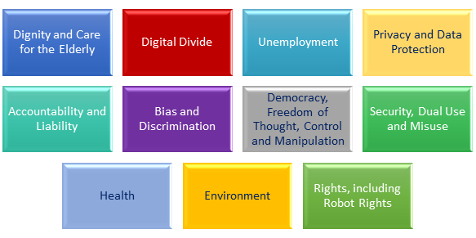
Human Rights Analysis

Slide 13

AI definition
EU AI Communication (April 2018)
  ‘Artificial intelligence (AI) refers to systems that display intelligent behaviour by analysing their environment and taking actions - with some degree of autonomy - to achieve specific goals’
“As soon as it works, no one calls it AI anymore …” (Meyer, McCarthy, 2011)
General (broad) AI v narrow AI

Slide 14

Search and Optimisation
Machine Learning
and Probabilistic
Reasoning
Fuzzy
Systems
Planning and
Decision Making
Neural
Networks
Natural Language
Processing and
Knowledge
Representation
Computer
Vision

Slide 15
Concepts of Ethics
Stahl, B. (2012). Morality, Ethics, and Reflection: A Categorization of Normative IS Research. Journal of the Association for Information Systems, 13(8). Retrieved from http://aisel.aisnet.org/jais/vol13/iss8/1

Slide 16

Current approaches: HLEG
Fundamental rights
Respect for human dignity
Freedom of the individual
Equality, non-discrimination and solidarity
Citizens’ rights.

Slide 17
Current approaches: HLEG 7 requirements

Slide 18

Current approaches: OECD
Values-based principles
inclusive growth, sustainable development and well-being;
human-centred values and fairness;
transparency and explainability;
robustness, security and safety;
and accountability.

Slide 19
Current approaches: OECD
Recommendations to policymakers
investing in AI research and development;
fostering a digital ecosystem for AI;
shaping an enabling policy environment for AI;
building human capacity and preparing for labour market transformation;
and international co-operation for trustworthy AI.

Slide 20
Convergence of recent guidelines
 | IEEE | HLEG | OECD | SIENNA/SHERPA
autonomy | ** | **** | *** | ****
freedom | *** | *** | *** | ***
dignity | *** | *** | *** | ***
privacy | **** | **** | *** | ****
safety/security | ** | **** | **** | ****
justice/fairness | ** | **** | **** | ****
accountability | **** | **** | **** | ****
transparency | **** | **** | **** | ****
indiv. well-being | **** | ** | **** | ***
soc/env well-b. | *** | **** | *** | ***

Slide 21
Human rights
Rights | ECHR | EUCFR
Right to human dignity |  | Article 1
Right to liberty and security | Article 5 | Article 6
Right to respect for private and family life | Article 8 | Article 7
Protection of personal data |  | Article 8
Freedom of thought, conscience and religion | Article 9 | Article 10
Prohibition of discrimination | Article 14; Article 1, Protocol 12 | Article 21
Right of property | Article 1, Protocol 1 | Article 17
Right to education | Article 1, Protocol 2 | Article 14
Right to free election | Article 3, Protocol 1 | Articles 39-40
Freedom to choose an occupation and right to engage in work |  | Article 15
Consumer protection |  | Article 38
Right to good administration |  | Article 41

Slide 22
What do we mean by “Ethics of AI”?
Human rights
Remedies often exit
Bias
Specific issues of machine learning
Discrimination
Security
Ethics of AI
Data protection
Politics
Autonomy
General questions about living in a digital world
(Economic) Power
Warfare
Superintelligence

Slide 23

Existing remedies for specific issues
Risk management (Clarke)
Information governance (ISO)
Development methodologies (e.g. value-sensitive design)
ICT professionalism, including guidelines
Product liability (something ICT companies are not used to)
Data Protection law
Competition law
Human rights law

Slide 24

General questions about a digital society
Human rights in business:
  CSR;
  OECD guidelines
Public engagement
Representative democracy
How to deal with the international nature of technology?

Slide 25

Some Observations
Pervasive technocentric and techno-optimistic view
What is new, what is specific to AI?
  Lack of conceptual clarity
  AI is part of computer science
  What happened to computer ethics, info ethics, ethics of technology?
What is the role of ethics, ethical principles?

Slide 26

So what?
Look beyond the hype
  What is really new?
  Which issues can be addressed with existing measures?
Clarify the role of ethics
  Ethics / rights / laws
  Gaps in the law (policy vacuum)
  Interpretation of the law
  Larger scale / social issues
Don’t look at AI or big data in isolation
Is technical innovation subject to democratic oversight?

