Slide 1
Model-based Joint Bit Allocation between Geometry and Color for Video-based 3D Point Cloud Compression
Reporter：Hui Yuan
Email： huiyuan@sdu.edu.cn

Slide 2
Personal Introduction
Research Interest:
data coding (including image/video/point cloud/light field, etc.)
video streaming (especially DASH)
computer vision (camera calibration, super resolution, colorization, etc.)
Resume
From 2016.09 Shandong University, Professor
2017.11-2018.02, City University of Hong Kong, Research Fellow
2015.01-2016.08 Shandong University, Associate Professor
2013.01-2014.12 City University of Hong Kong, Hong Kong Scholar
2011.04-2014.12 Shandong University, Lecturer
2006.09-2011.03 Xidian University, Ph.D Study
2002.09-2006.06 Xidian University, Bachelor Study

Slide 3
Outline
1. Background and Preliminary
2. Standardization for 3DPC coding
3. Motivation
4. Methodology
5. Experimental Results
6. Conclusion

Slide 4
Outline
1. Background and Preliminary
3. Standardization for 3DPC coding
4. Motivation
4. Methodology
5. Experimental Results
6. Conclusion

Slide 5
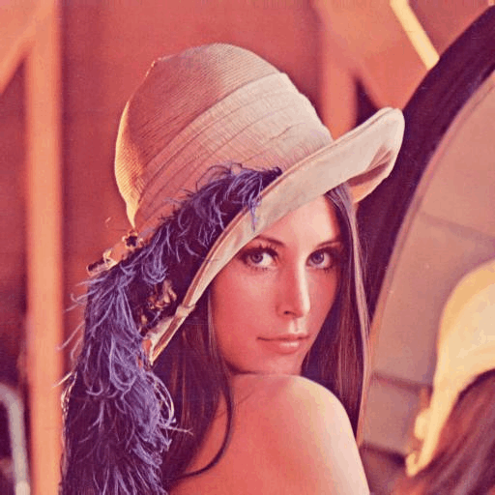
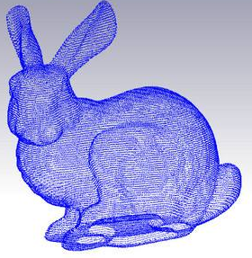
Background and Preliminary
Picture
2D video
3D video
3DPC
Light Field
Traditional Media
qusi-Immersive Media
Immersive Media
3DPC application
Notes:
historical heritage

Slide 6
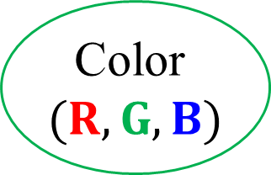
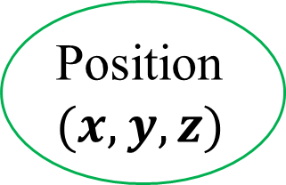
Background and Preliminary
Position $(x,y,z)$
Color $(R,G,B)$
Point
Other attribute
Normal vector
A 3DPC is composed of tens of thousands of points, each point contains geometry, color, normal vector, reflectivity and transmissivity, etc.
Notes:
三维点云通常由数万乃至数千万点组成，每个点包含三维几何信息，颜色信息，法向信息，以及反射率透射率等，数据量巨大

Slide 7
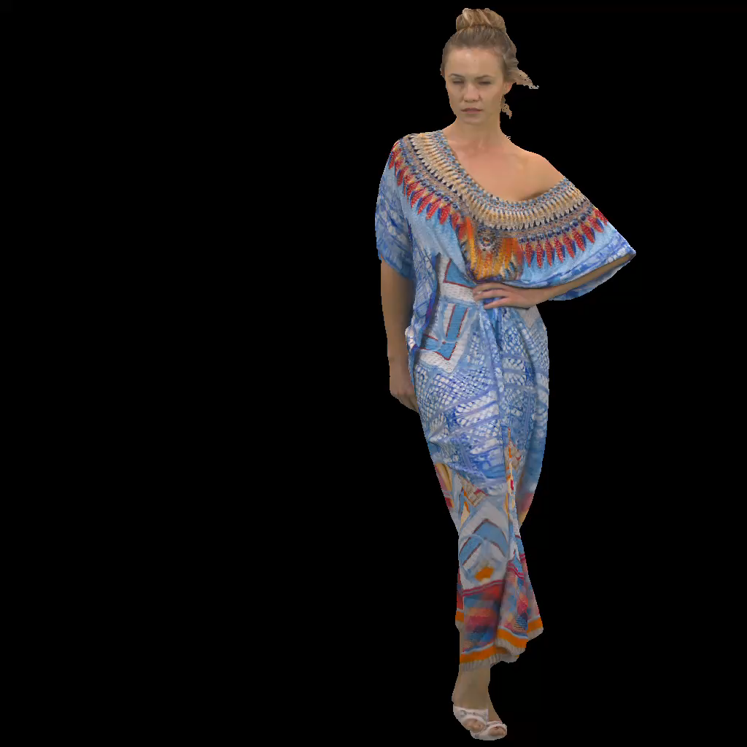
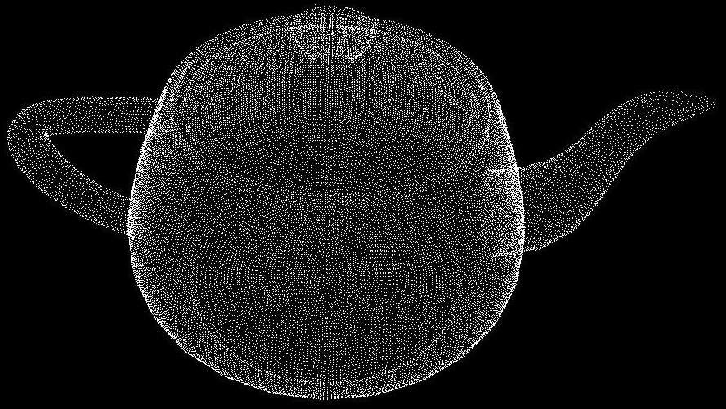

Background and Preliminary
3DPC
$$X=\left(x,y,z,r,g,b\right)∈ℝ^{N×6}$$

Slide 8
Outline
1. Background and Preliminary
2. Standardization for 3DPC coding
3. Motivation
4. Methodology
5. Experimental Results
6. Conclusion

Slide 9
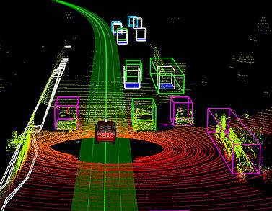
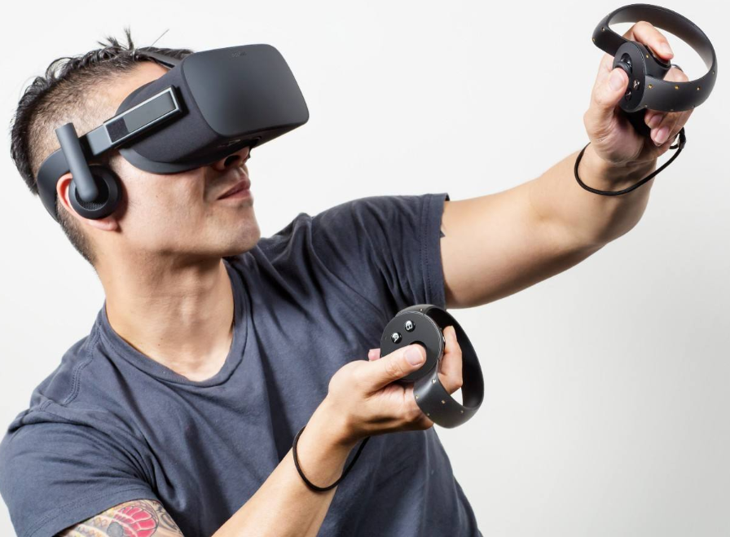
Standardization for 3DPC Coding: MPEG
Coding Platform
Video-based PCC (V-PCC)
Geometry-based PCC (G-PCC)
Immersive communication (VR/AR)
Autonomous Driving
History Heritage
Large Scale Sparse 3DPC
Dense 3DPC
Requirement
Call for
Proposals
Standardization
Release
2016
Ongoing

Slide 10
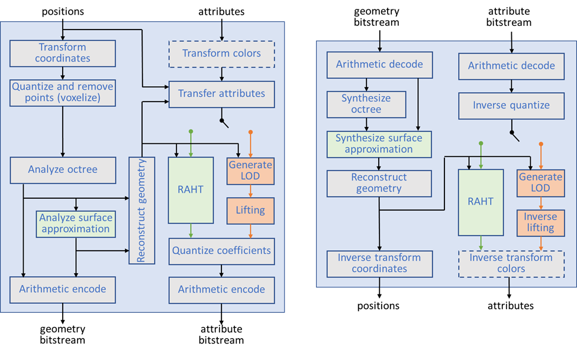
Standardization for 3DPC Coding: G-PCC
Encoder
Decoder
There are three kinds of encoder configurations for G-PCC, i.e., Region adaptive Haar Transform (RAHT), prediction transform, and lift transform.

Slide 11
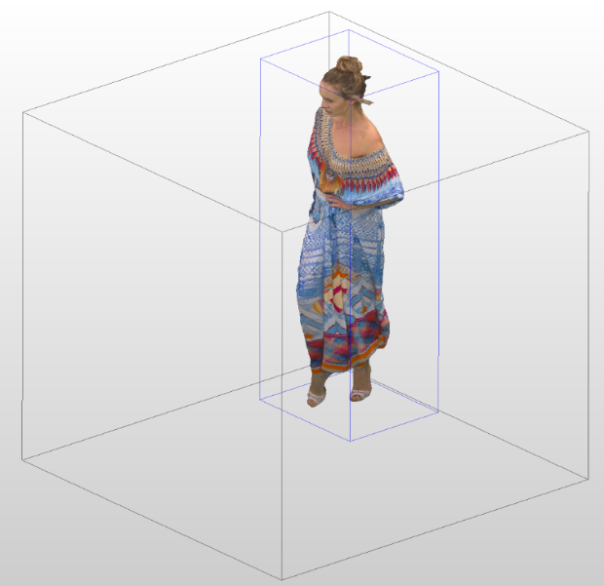
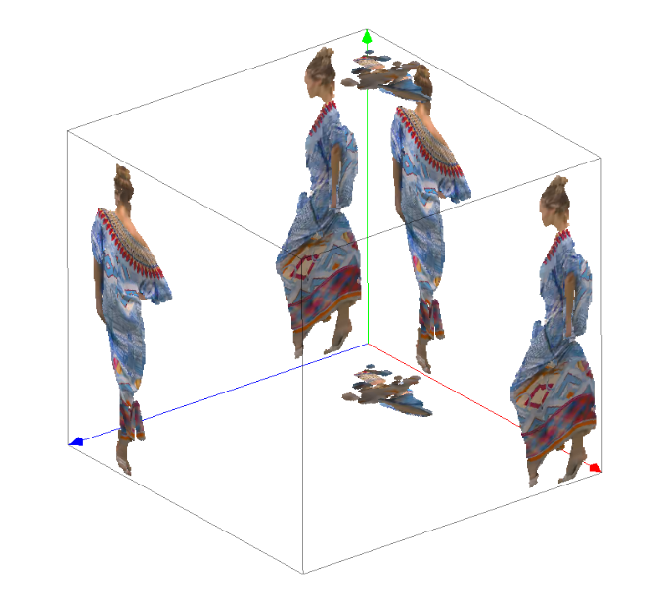
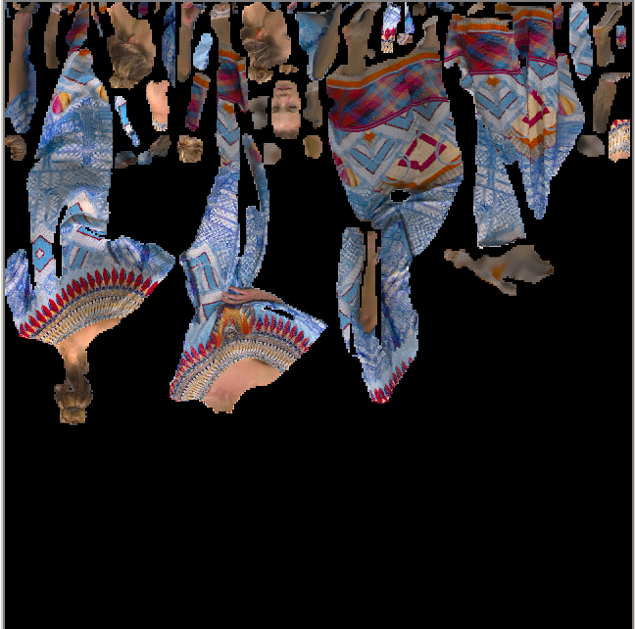
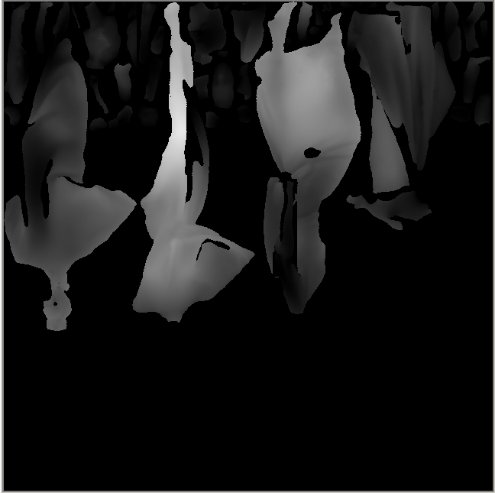
Standardization for 3DPC Coding: V-PCC
Patch generation
Patch packing
Color and geometry information are projected as patches onto six planes, and the patches are combined together to generate the geometry video and color video. Then the generated videos are encoded by existing video coding standards, e.g., H.265/HEVC.

Slide 12
Standardization for 3DPC Coding: V-PCC
V-PCC
3
1
2

Slide 13
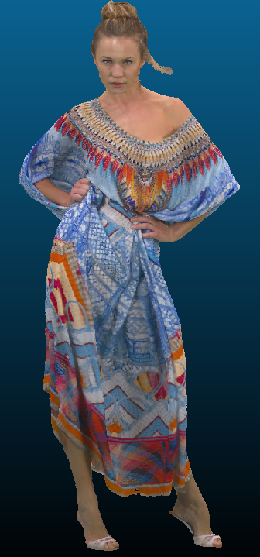
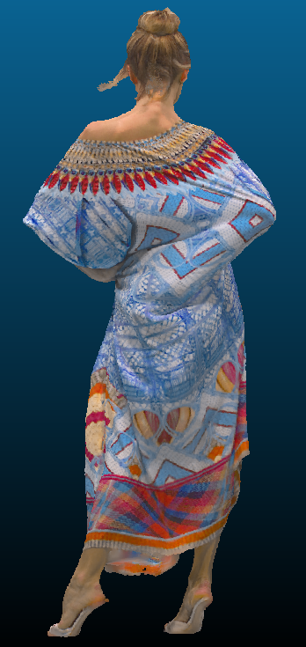
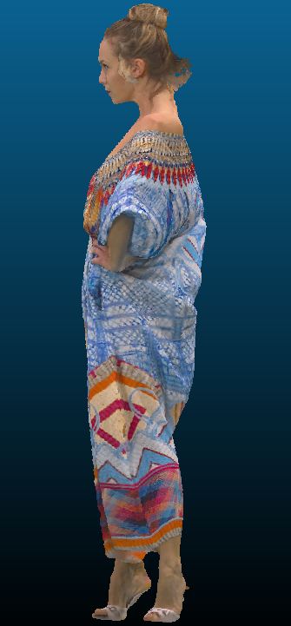
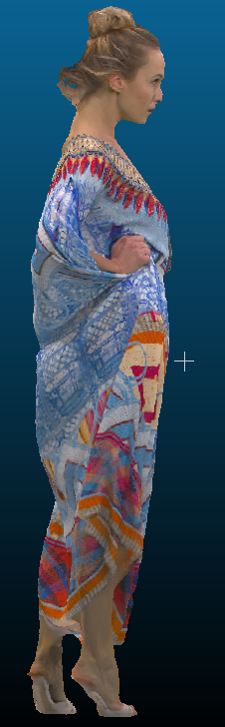
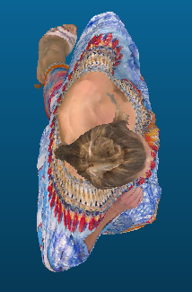
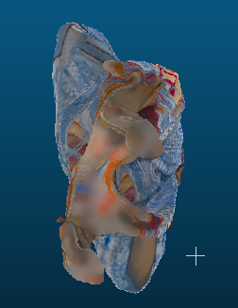
Standardization for 3DPC Coding: V-PCC
V-PCC: Patch Generation
(1) Front Projection
(2) Back Projection
(3) Left Projection
(4) Right Projection
Six main projections
(5) Up Projection
(6) Down Projection

Slide 14
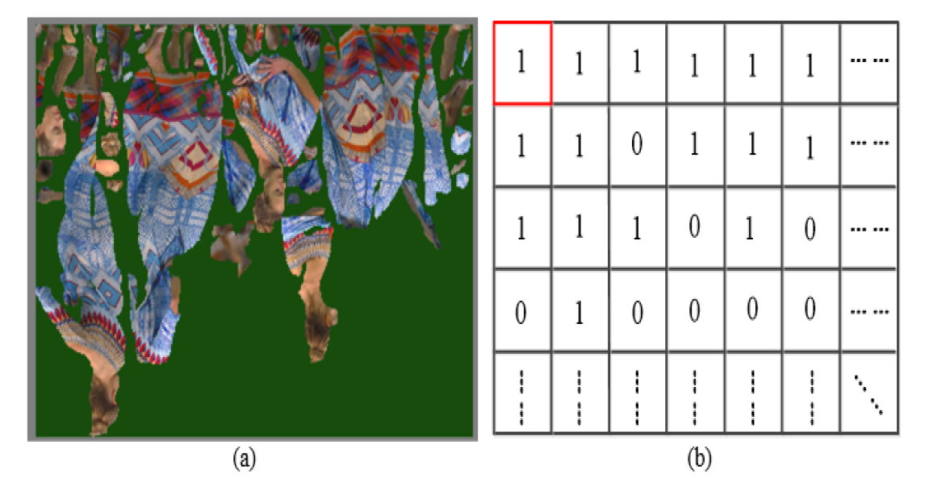
Standardization for 3DPC Coding: V-PCC
V-PCC: Patch Packing
Patch packing is to arrange each patch onto a predefined 2D grid compactly. An auxiliary map denotes which position of the 2D grid is occupied is also generated.

Slide 15
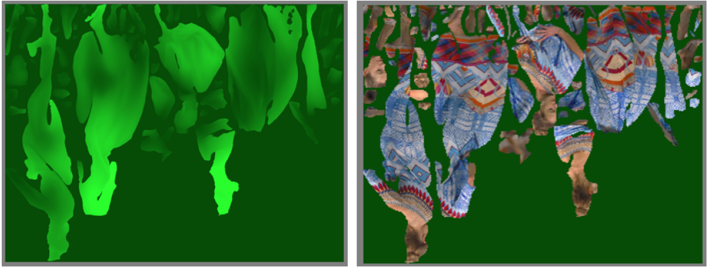
Standardization for 3DPC Coding: V-PCC
V-PCC: Video Generation
(a) Geometry Video (b) Color Video

Slide 16
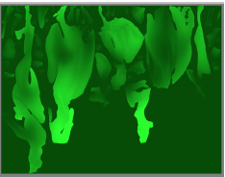
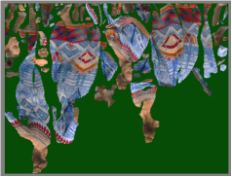
Standardization for 3DPC Coding: V-PCC
V-PCC: Video Compression
Video encoder
Video decoder
Reconstructed
Geometry
Reconstructed geometry
Generated
Color video
Reconstructed
Color
Video decoder
Video encoder

Slide 17
Outline
1. Background and Preliminary
2. Standardization for 3DPC coding
3. Motivation
4. Methodology
5. Experimental Results
6. Conclusion

Slide 18
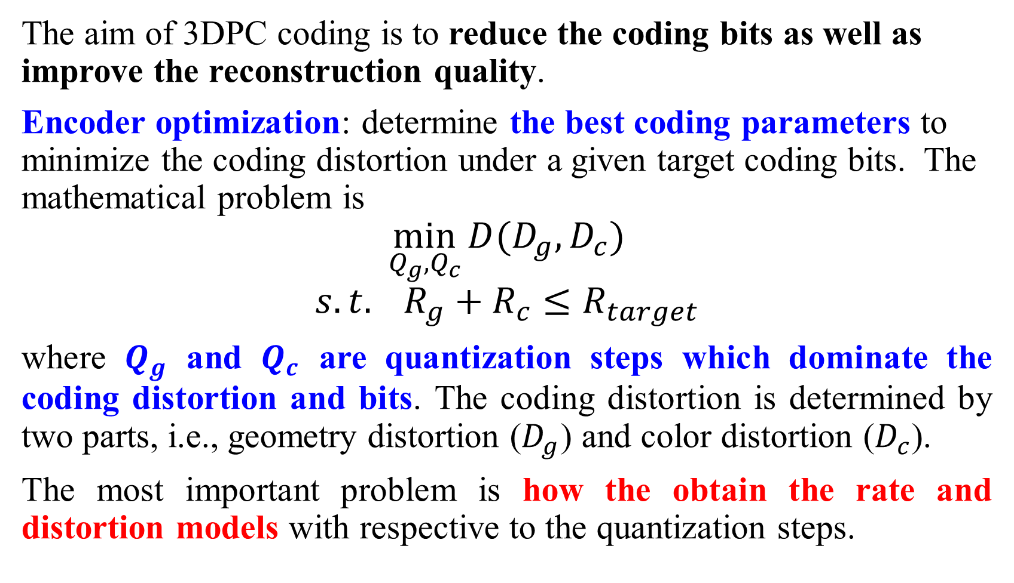
Motivation
The aim of 3DPC coding is to reduce the coding bits as well as improve the reconstruction quality.
Encoder optimization: determine the best coding parameters to minimize the coding distortion under a given target coding bits. The mathematical problem is
$$\min_{Q_{g},Q_{c}}{D(D_{g},D_{c})}$$
$$s.t. R_{g}+R_{c}≤R_{target}$$
where $Q_{g}$ and $Q_{c}$ are quantization steps which dominate the coding distortion and bits. The coding distortion is determined by two parts, i.e., geometry distortion ($D_{g}$) and color distortion ($D_{c}$).
The most important problem is how the obtain the rate and distortion models with respective to the quantization steps.

Slide 19
Outline
1. Background and Preliminary
2. Standardization for 3DPC coding
3. Motivation
4. Methodology
5. Experimental Results
6. Conclusion

Slide 20
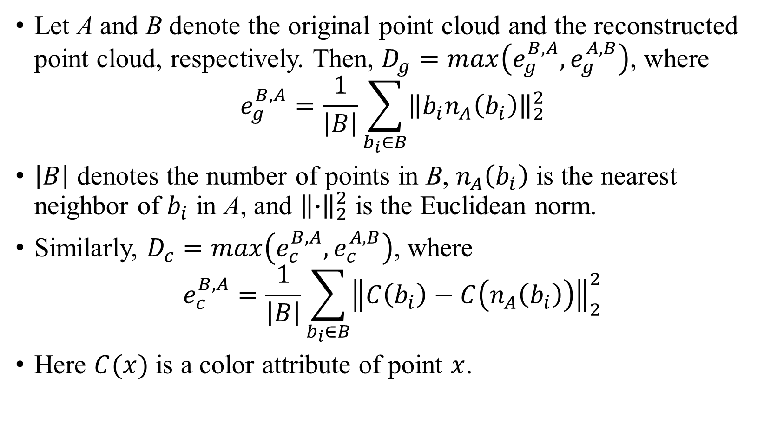
Methodology: Definition
Let A and B denote the original point cloud and the reconstructed point cloud, respectively. Then, $D_{g}=max\left(e_{g}^{B,A},e_{g}^{A,B}\right)$, where
$$e_{g}^{B,A}=\frac{1}{\left|B\right|}\sum_{b_{i}∈B}{{\left\|b_{i}n_{A}\left(b_{i}\right)\right\|}_{2}^{2}}$$
$\left|B\right|$ denotes the number of points in B, $n_{A}\left(b_{i}\right)$ is the nearest neighbor of $b_{i}$ in A, and ${\left\|∙\right\|}_{2}^{2}$ is the Euclidean norm.
Similarly, $D_{c}=max\left(e_{c}^{B,A},e_{c}^{A,B}\right)$, where
$$e_{c}^{B,A}=\frac{1}{\left|B\right|}\sum_{b_{i}∈B}{{\left\|C\left(b_{i}\right)−C\left(n_{A}\left(b_{i}\right)\right)\right\|}_{2}^{2}}$$
Here $C(x)$ is a color attribute of point $x$.

Slide 21
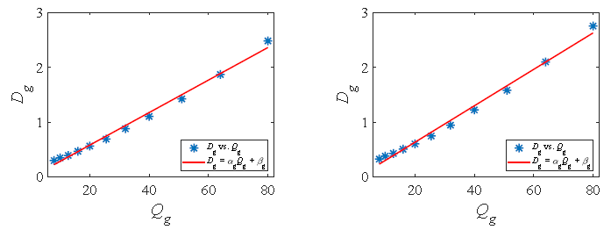
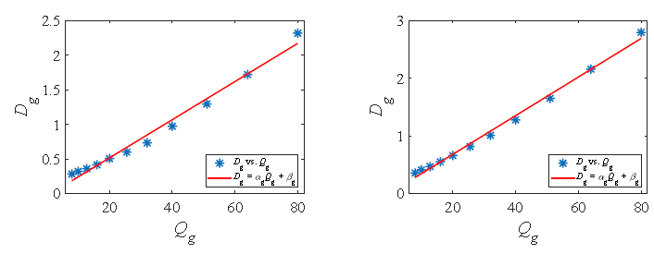



Methodology: Distortion Model
Statistical analysis and verification for $D_{g}$
Illustration of the relationship between $D_{g}$and $Q_{g}$
(a) Loot
(b) Longdress
$$D_{g}=α_{g}Q_{g}+β_{g}$$
(c) Queen
(d) Redandblack

Slide 22
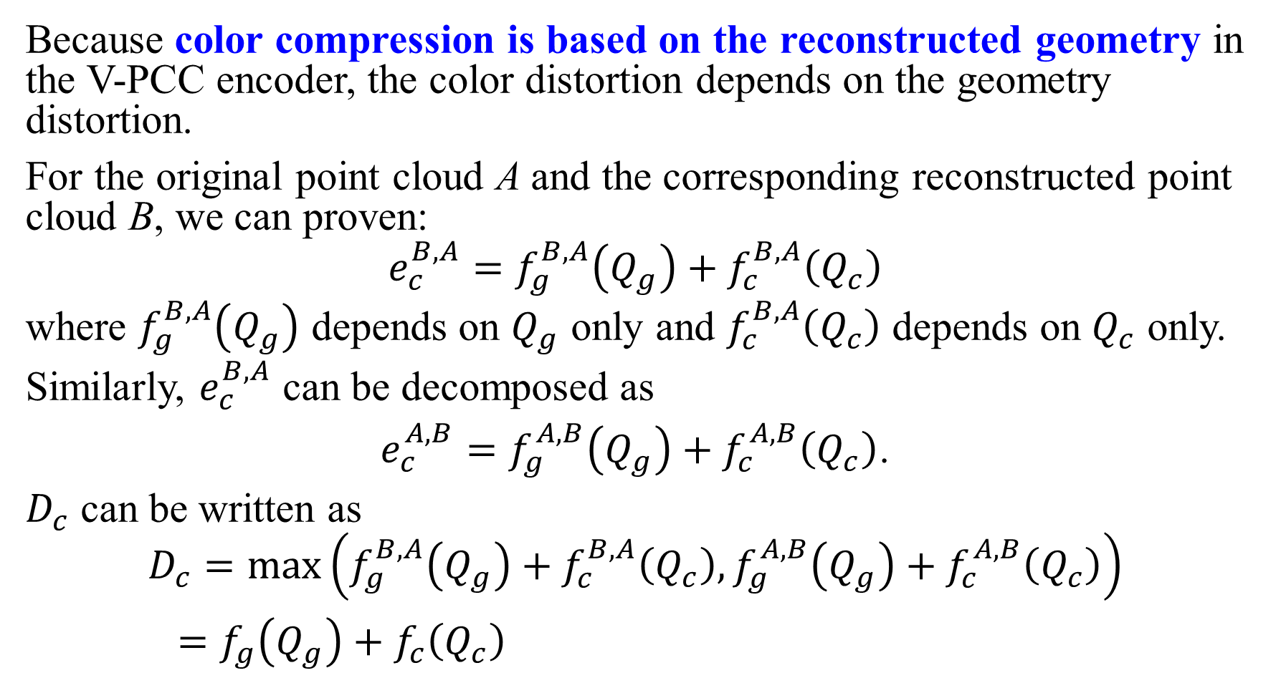
Methodology: Distortion Model
Because color compression is based on the reconstructed geometry in the V-PCC encoder, the color distortion depends on the geometry distortion.
For the original point cloud A and the corresponding reconstructed point cloud B, we can proven:
$$e_{c}^{B,A}=f_{g}^{B,A}\left(Q_{g}\right)+f_{c}^{B,A}\left(Q_{c}\right)$$
where $f_{g}^{B,A}\left(Q_{g}\right)$ depends on $Q_{g}$ only and $f_{c}^{B,A}\left(Q_{c}\right)$ depends on $Q_{c}$ only. Similarly, $e_{c}^{B,A}$ can be decomposed as
$e_{c}^{A,B}=f_{g}^{A,B}\left(Q_{g}\right)+f_{c}^{A,B}\left(Q_{c}\right)$.
$D_{c}$ can be written as
$$D_{c}=\max\left(f_{g}^{B,A}\left(Q_{g}\right)+f_{c}^{B,A}\left(Q_{c}\right),f_{g}^{A,B}\left(Q_{g}\right)+f_{c}^{A,B}\left(Q_{c}\right)\right)$$
$=f_{g}\left(Q_{g}\right)+f_{c}\left(Q_{c}\right)$

Slide 23
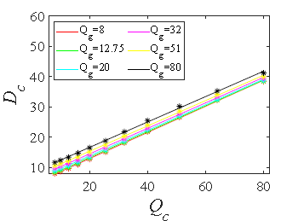
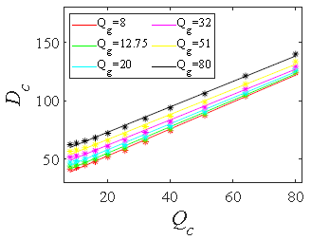
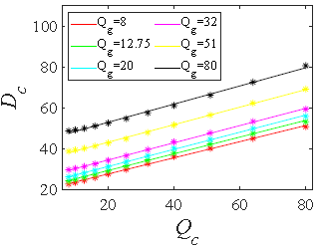
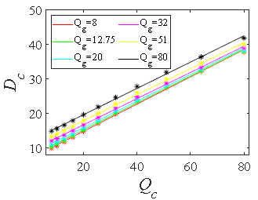
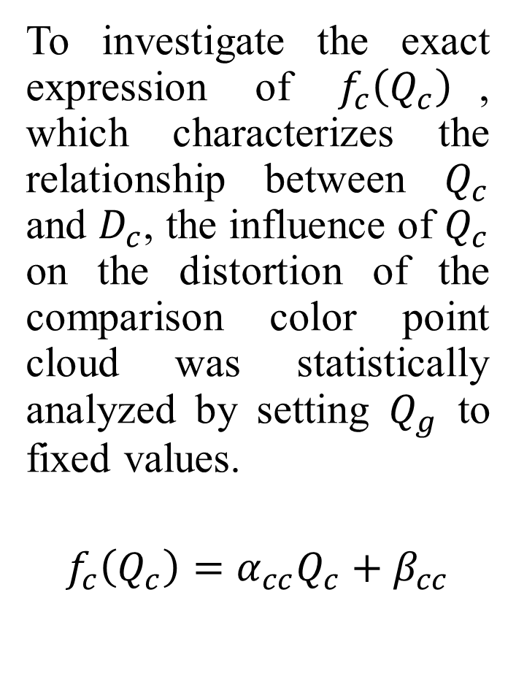
Methodology: Distortion Model
To investigate the exact expression of $f_{c}\left(Q_{c}\right)$, which characterizes the relationship between $Q_{c}$ and $D_{c}$, the influence of $Q_{c}$ on the distortion of the comparison color point cloud was statistically analyzed by setting $Q_{g}$ to fixed values.
$$f_{c}\left(Q_{c}\right)=α_{cc}Q_{c}+β_{cc}$$
(a) Loot
(b) Longdress
(c) Queen
(d) Redandblack

Slide 24
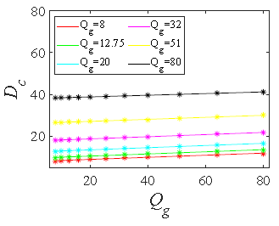
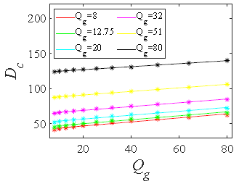
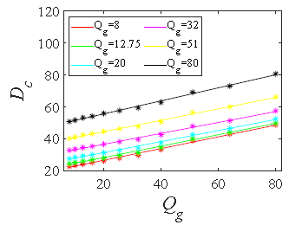
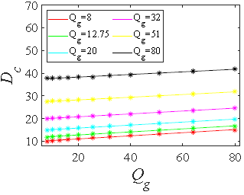
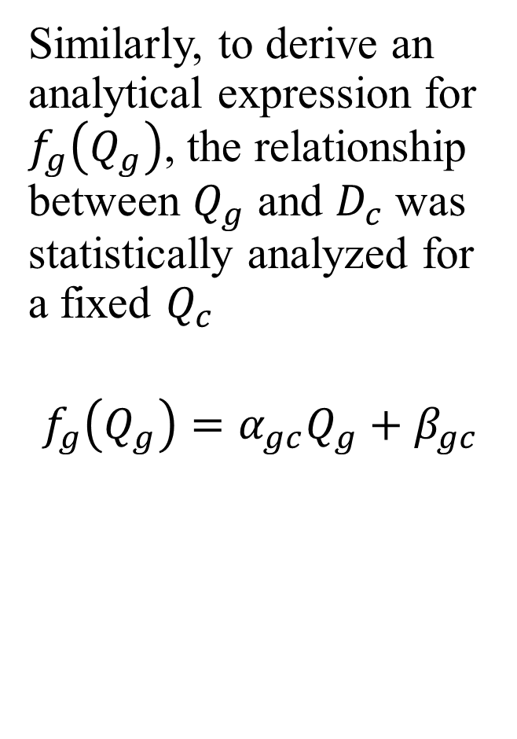
Methodology: Distortion Model
Similarly, to derive an analytical expression for $f_{g}\left(Q_{g}\right)$, the relationship between $Q_{g}$ and $D_{c}$ was statistically analyzed for a fixed $Q_{c}$
$$f_{g}\left(Q_{g}\right)=α_{gc}Q_{g}+β_{gc}$$
(a) Loot
(b) Longdress
(c) Queen
(d) Redandblack

Slide 25




Methodology: Distortion Model
Consequently, the color distortion can be finally written as
$$D_{c}=α_{gc}Q_{g}+β_{gc}+α_{cc}Q_{c}+β_{cc}$$
$$=α_{gc}Q_{g}+α_{cc}Q_{c}+β_{c}$$
Finally, we use a linear combination of geometry and color distortion to describe the distortion of a 3DPC:
$$D=ωD_{g}+\left(1−ω\right)D_{c}$$
$$=ω\left(α_{g}Q_{g}+β_{g}\right)+\left(1−ω\right)(α_{gc}Q_{g}+α_{cc}Q_{c}+β_{c})$$
$$=aQ_{g}+bQ_{c}+c$$
$ω$ is empirically set to be 0.5

Slide 26
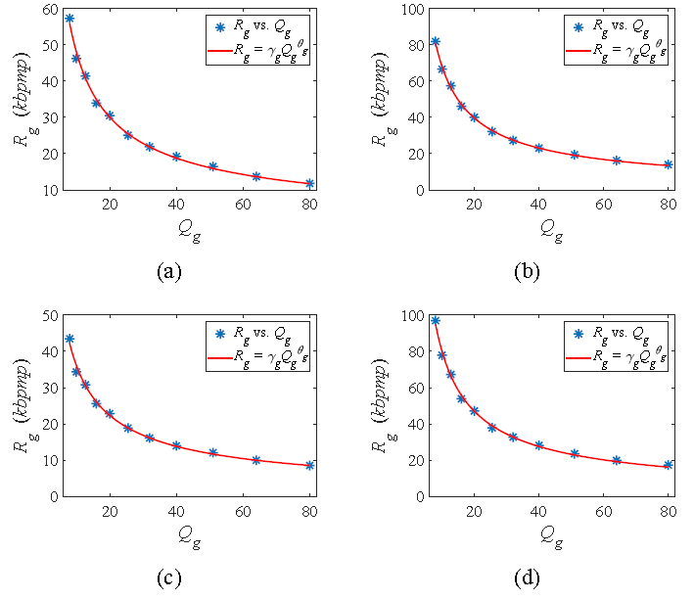
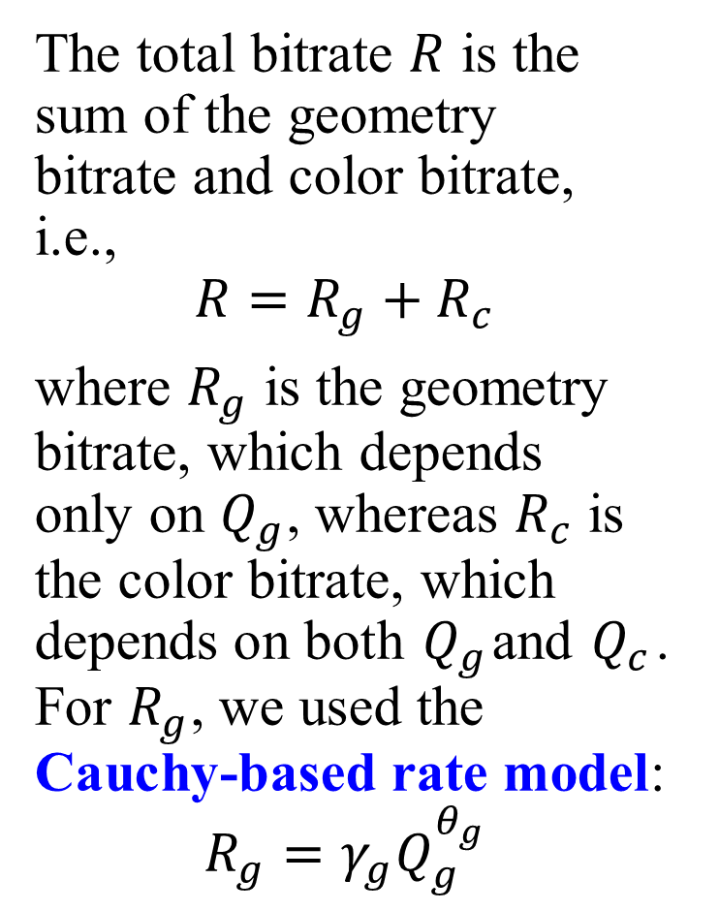
Methodology: Rate Model
The total bitrate $R$ is the sum of the geometry bitrate and color bitrate, i.e.,
$$R=R_{g}+R_{c}$$
where $R_{g}$ is the geometry bitrate, which depends only on $Q_{g}$, whereas $R_{c}$ is the color bitrate, which depends on both $Q_{g}$and $Q_{c}$. For $R_{g}$, we used the Cauchy-based rate model:
$$R_{g}=γ_{g}Q_{g}^{θ_{g}}$$
Loot
Longdress
Queen
Redandblack

Slide 27
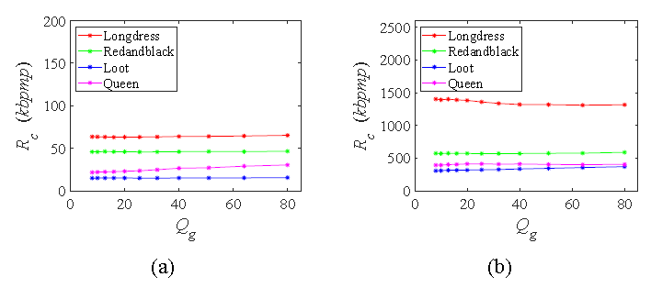

Methodology: Rate Model
To study the effect of $Q_{g}$ on $R_{c}$, we compressed the color information with a fixed $Q_{c}$ and multiple $Q_{g}$s. The results indicate that the effect of $Q_{g}$ on $R_{c}$ is negligible. Therefore, $R_{c}=γ_{c}Q_{c}^{θ_{c}}$
Influence of $Q_{g}$ on $R_{c}$. (a) $Q_{c}$=80, $Q_{g}$ = 8, 10, . . . , 80; (b) $Q_{c}$=8, $Q_{g}$ = 8, 10, . . . , 80.

Slide 28
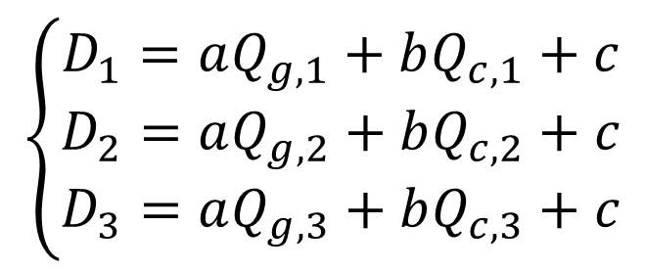
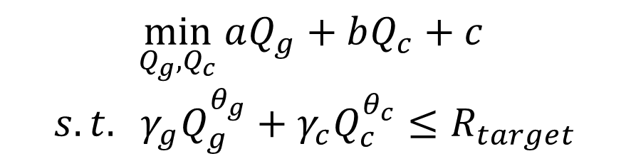
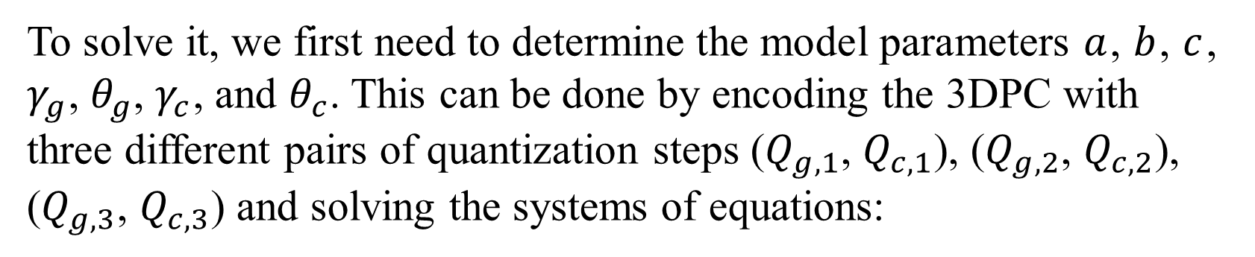
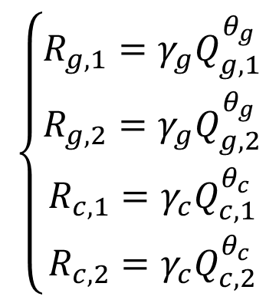
Methodology: Solution
The optimization problem can be rewritten as
$$\min_{Q_{g},Q_{c}}{aQ_{g}+bQ_{c}+c }$$
$$s.t. γ_{g}Q_{g}^{θ_{g}}+γ_{c}Q_{c}^{θ_{c}}≤R_{target}$$
To solve it, we first need to determine the model parameters $a$, $b$, $c$, $γ_{g}$, $θ_{g}$, $γ_{c}$, and $θ_{c}$. This can be done by encoding the 3DPC with three different pairs of quantization steps ($Q_{g,1}$, $Q_{c,1}$), ($Q_{g,2}$, $Q_{c,2}$), ($Q_{g,3}$, $Q_{c,3}$) and solving the systems of equations:
$$\left\{\begin{aligned}R_{g,1}=γ_{g}Q_{g,1}^{θ_{g}} \\ R_{g,2}=γ_{g}Q_{g,2}^{θ_{g}} \\ R_{c,1}=γ_{c}Q_{c,1}^{θ_{c}} \\ R_{c,2}=γ_{c}Q_{c,2}^{θ_{c}}\end{aligned}\right.$$
$$\left\{\begin{aligned}D_{1}=aQ_{g,1}+bQ_{c,1}+c \\ D_{2}=aQ_{g,2}+bQ_{c,2}+c \\ D_{3}=aQ_{g,3}+bQ_{c,3}+c\end{aligned}\right.$$

Slide 29
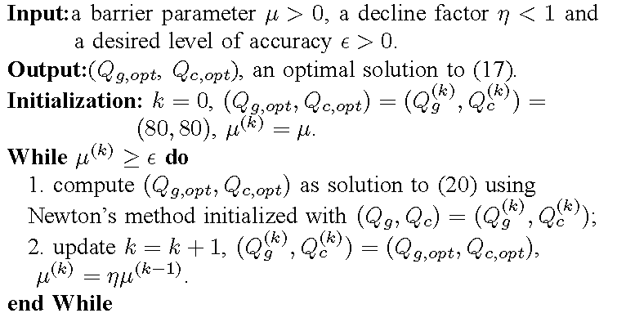
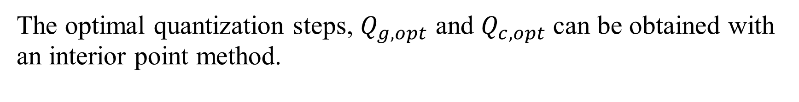
Methodology: Solution
The optimal quantization steps, $Q_{g,opt}$ and $Q_{c,opt}$ can be obtained with an interior point method.
$$\min_{Q_{g},Q_{c}}\left(aQ_{g}+bQ_{c}+c\right)−μlog⁡\left[−\left(γ_{g}Q_{g}^{θ_{g}}+γ_{c}Q_{c}^{θ_{c}}−R_{target}\right)\right]$$
Barrier method for the constrained optimization

Slide 30
Outline
1. Background and Preliminary
2. Standardization for 3DPC coding
3. Motivation
4. Methodology
5. Experimental Results
6. Conclusion

Slide 31


Experimental Results
Experiments Setup
Coding platform V-PCC: TMC2 version9.0 with HM16.20
Quality evaluation software: PC_error provided by MPEG
barrier parameter $μ$, decline factor $η$, level of accuracy $ε$ were set to 0.1, ${10}^{−6}$, and ${10}^{−10}.$
Comparison: Exhaustive Search-based Algorithm (ESA)
Test information

Slide 32

Experimental Results
3D point cloud sequences used in the experiments. (a) Andrew, (b) Longdress, (c) Redandblack, (d) David, (e) Loot , (f) Queen, (g) Soldier, (h) Basketballplayer

Slide 33

Experimental Results: RD Performance
R-D performance of the proposed algorithm (PBA) and exhaustive search (ESA). (a)Andrew, (b)Longdress , (c)Redandblack, (d)David, (e)Loot, (f)Queen, (g)Soldier, (h)Basketballplayer.

Slide 34

Experimental Results: Bit allocation Accuracy

Slide 35

Experimental Results: Complexity Comparison

Slide 36
Outline
1. Background and Preliminary
2. Standardization for 3DPC coding
3. Motivation
4. Methodology
5. Experimental Results
6. Conclusion

Slide 37
Conclusion
Contributions：
The first rate and distortion models for 3DPCs;
The first rate control/bit allocation algorithm for 3DPCs.
Represent the distortion of a 3DPC as the linear combination of its geometry and color distortion. This has been verified by our another study (submitted).
Shortage：
Model parameters should be calculated by pre-encoding which is still time consuming
Future work：
Subjective quality metric for 3DPC
Subjective quality-based rate-distortion optimization for 3DPC
Frame level bit allocation for 3DPC by taking inter-frame quality variation into account

Slide 38
Thank you!

