Slide 1
Booking System
Some pointers

Slide 2
Booking Systems
Often done poorly
They can be difficult
Often miss out important use cases

Slide 3
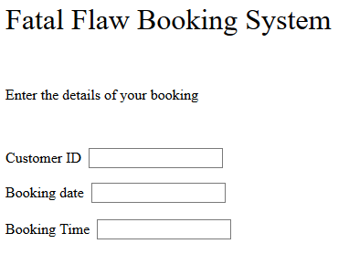
What is Wrong with this?

Slide 4
The Problems
Use of Customer ID
Missing use cases
Guessing game with nearly 90% chance of failure!
 | Monday
9:00 | Booked
10:00 | Booked
11:00 | Booked
12:00 | Booked
13:00 | Lunch
14:00
15:00 | Booked
16:00 | Booked

Slide 5
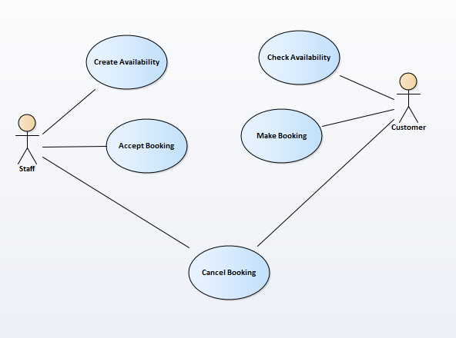
The Missed Use Cases
Check Availability
Create Availability
Lots of variation so let’s look at two examples

Slide 6
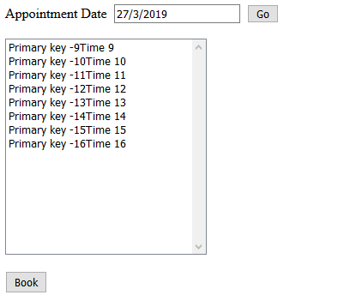
Example 1 Daily Appointments
GP appointments or car repairs
Notice how it works

Slide 7
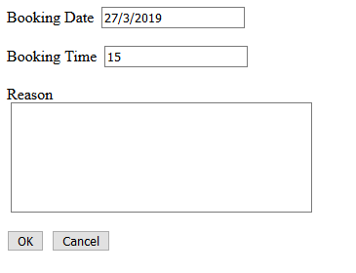
Create Booking
Date and time completed automatically
This example uses the query string
http://localhost:50577/MakeBooking.aspx?BookingDate=27/3/2019&BookingTime=-15
Not very secure but shows how it works

Slide 8
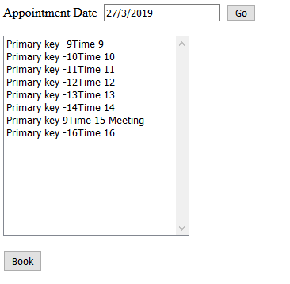
Once the booking is made...

Slide 9
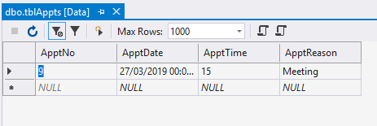
The problem...
Don’t want to create dummy records
Only 1 booking – only 1 record!

Slide 10
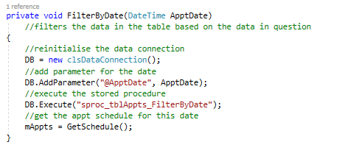
FilterByDate

Slide 11
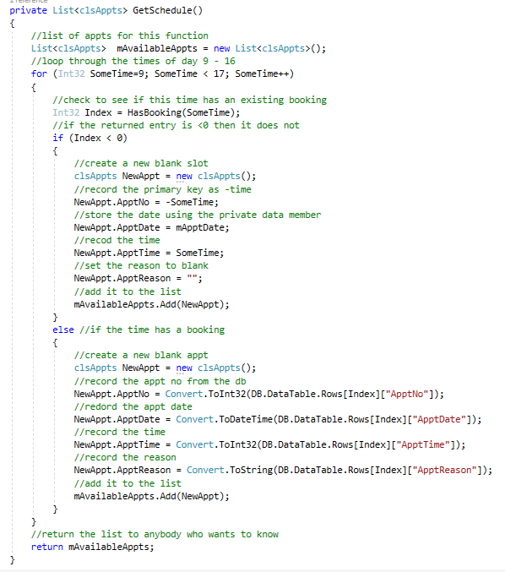
GetSchedule

Slide 12
Example 2 Availability between Dates
Your booking 10th ------ 12th
Car 1 Booked 1st ------ 9th
Car 2 Booked 11th ------ 14th
Based on the logic above which car is available?

Slide 13
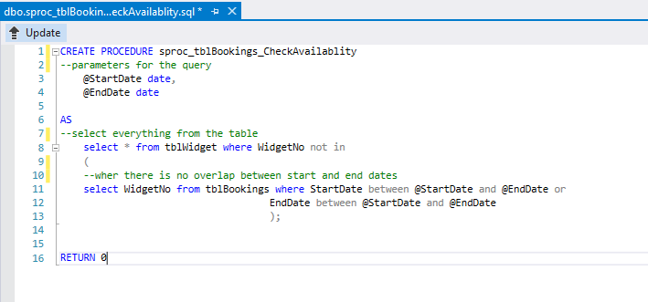
Stored Procedure

Slide 14
Not in
Create a list of unavailable items
  select WidgetNo from tblBookings where
  StartDate between @StartDate and @EndDate
  Or
  EndDate between @StartDate and @EndDate
Now list those items not in that first list
select * from tblWidget where WidgetNo not in

Slide 15
Closing Remarks
Lots of variations – can’t cover all options
Don’t forget use cases
  Check Availability
  Create Availability
Examples not perfect but should help you get started
Examine the code at all layers to understand how it works

